Slide 1
BUSINESS OBJECTIVE
A data engineering project on employees of the one of the big corporation from the 1980s and 1995s. In this project , the objective is to create end-to- end data pipeline and analyze the data to get meaningful insights from the data.

Slide 2
CSV DATA FILES USED: EMPLOYEES : emp_no – Int – Not Null emp_titles_id – Not Null birth_date – Date Time – Not Null first_name - Character – Not Null last_name - Character – Not Null sex – Character – Not Null hire_date –Date Time -Not Null no_of_projects – Integer – Not Null Last_performance_rating – Character – Not Null left – Boolean – Not Null Last_date - Date Time DEPARTMENTS: dept_no - character – Not Null dept_name – Character – Not Null DEPARTMENT MANAGERS : dept_no – character – Not Null emp_no – Integer – Not Null DEPARTMENT EMPLOYEES : emp_no – Integer – Not Null dept_no – character – Not Null SALARIES : emp_no – Integer – Not Null Salary – Integer – Not Null TITLES: title_id – Character – Not Null Title – Character – Not Null
DATA USED AND ITS DESCRIPTION

Slide 3
1) MysQL (to create database) 2) Linux Commands 3) Sqoop (Transfer data from MySQL Server to HDFS/Hive) 4) HDFS (to store the data) 5) Hive (to create database) 6) Impala (to perform the EDA) 7) SparkSQL (to perform the EDA) 8) SparkML (model building)
TECHNOLOGY STACK USED

Slide 4
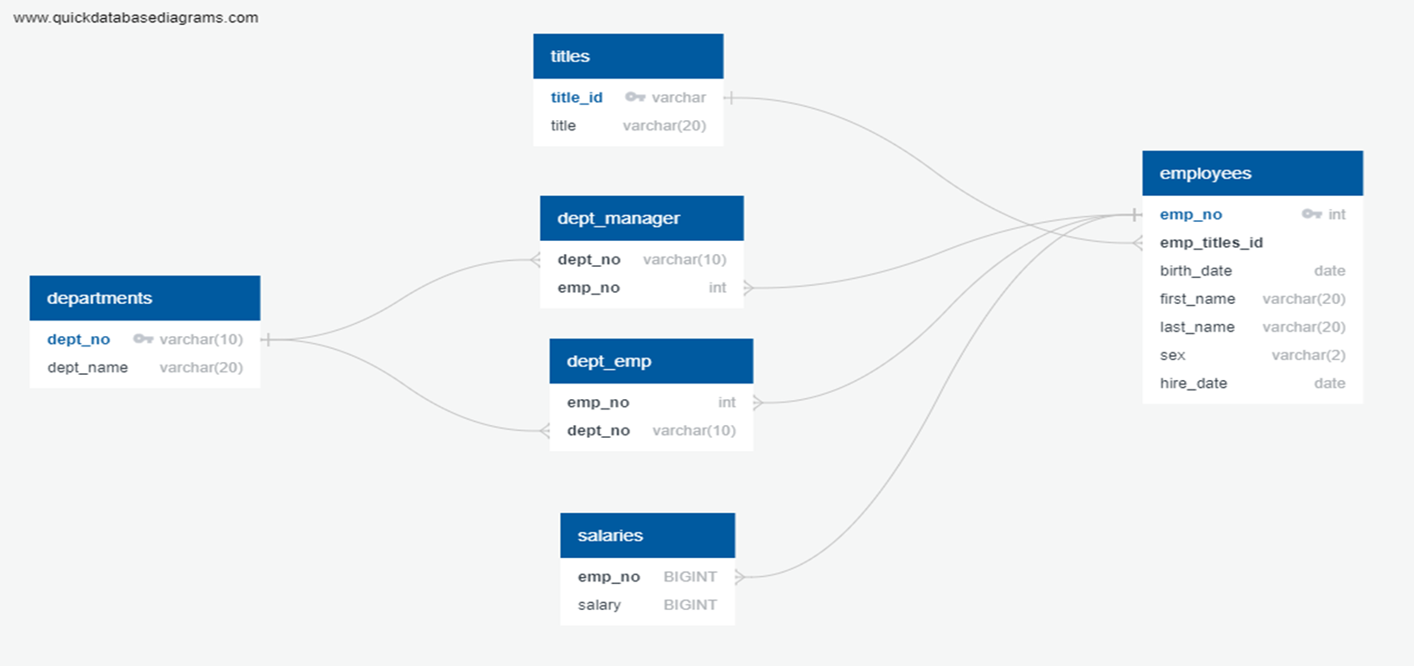
ER MODEL(DATA MODEL)

Slide 5
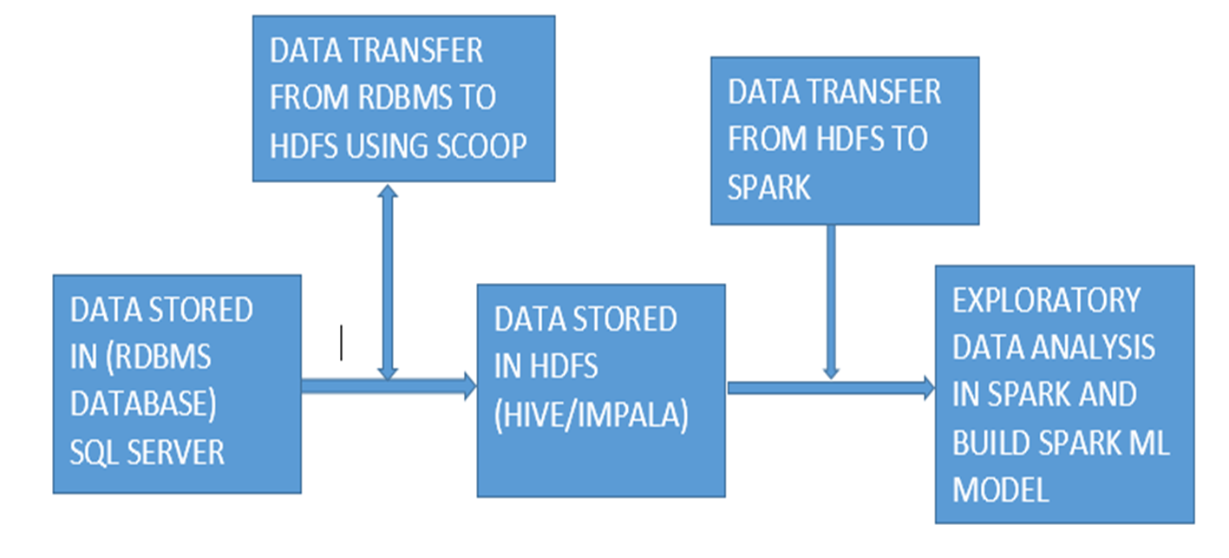
DATA PIPELINE ARCHITECTURE

Slide 6
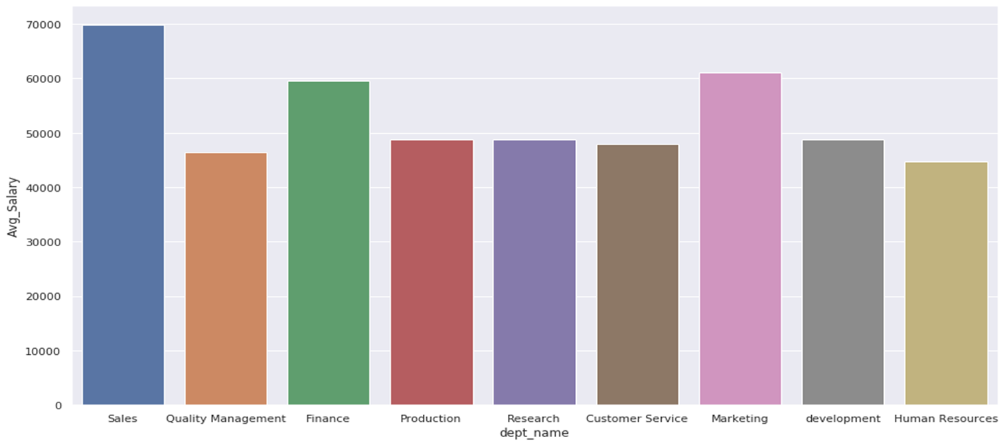
Average salary per department
EXPLORATORY DATA ANALYSIS

Slide 7
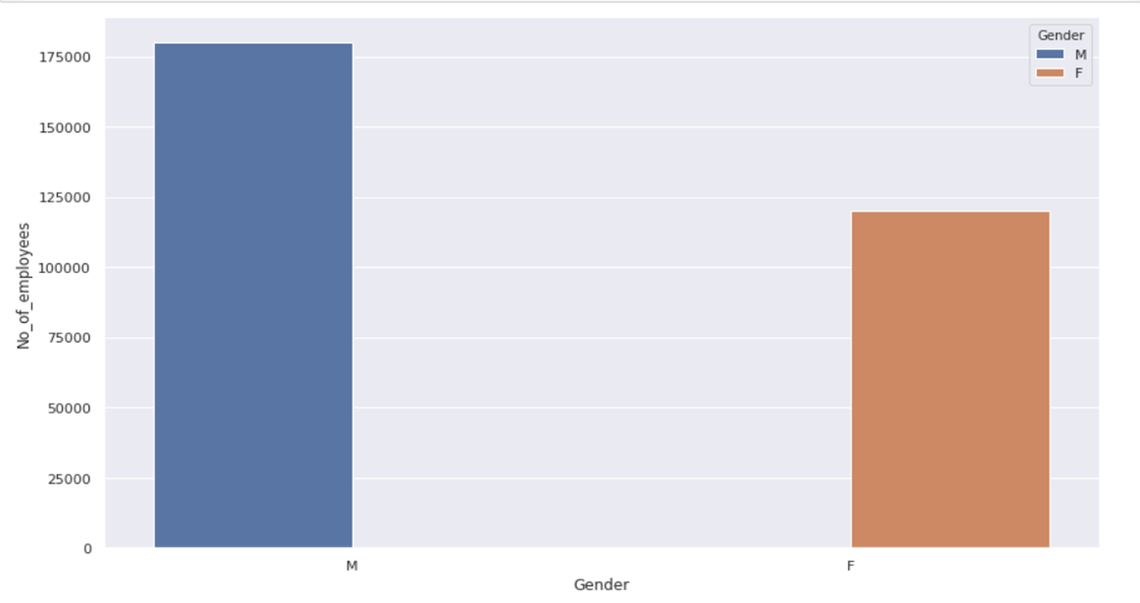
GENDER WISE EMPLOYEE COUNT

Slide 8
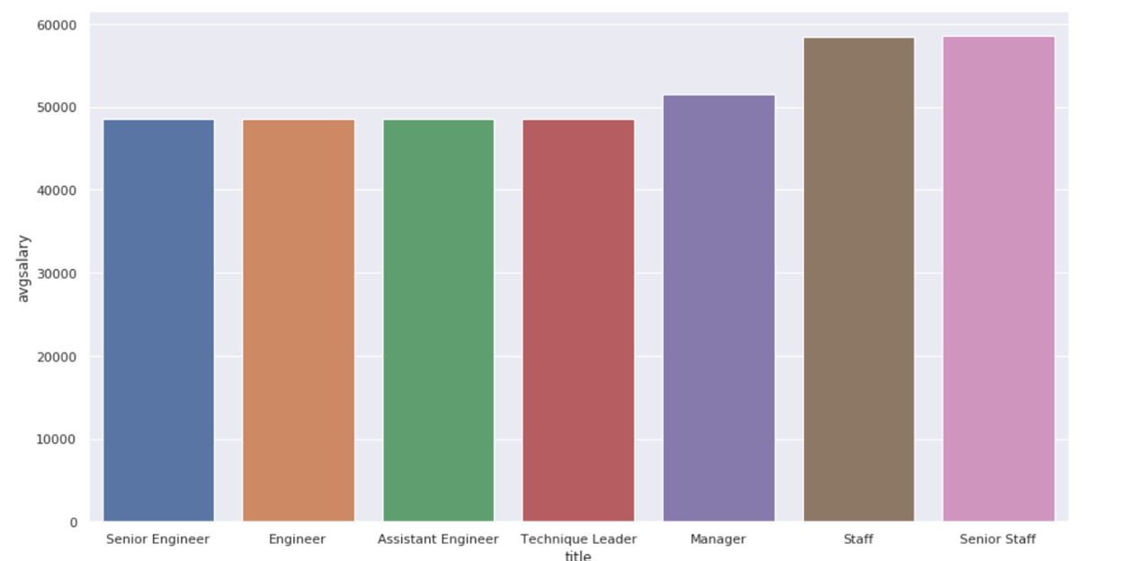
AVERAGE SALARY PER TITLE

Slide 9
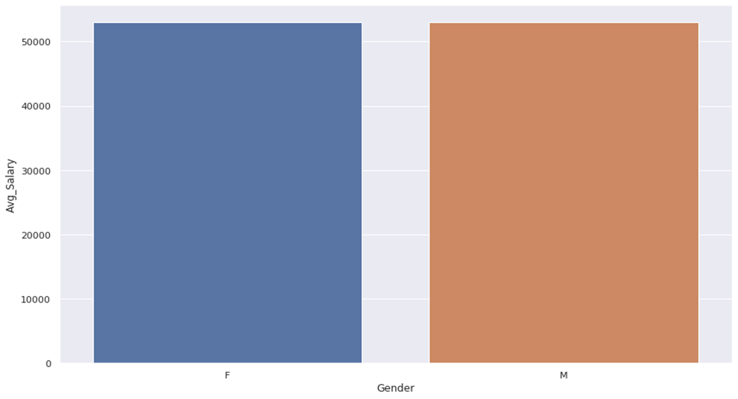
GENDER WISE AVERAGE SALARY

Slide 10
CHALLENGES FACED
1)Importing all the tables from MySQL to HDFS
2)Data transfer from MySQL to HDFS using Sqoop
3)Building ML Model and creating ML pipeline
4)Creating the entire Data pipeline

